Slide 1
The String Class
Constructing a String:
  String message = "Welcome to Java“;
  String message = new String("Welcome to Java“);
  String s = new String();
Obtaining String length and Retrieving Individual Characters in a string
String Concatenation (concat)
Substrings (substring(index), substring(start, end))
Comparisons (equals, compareTo)
String Conversions
Finding a Character or a Substring in a String
Conversions between Strings and Arrays
Converting Characters and Numeric Values to Strings

Slide 2
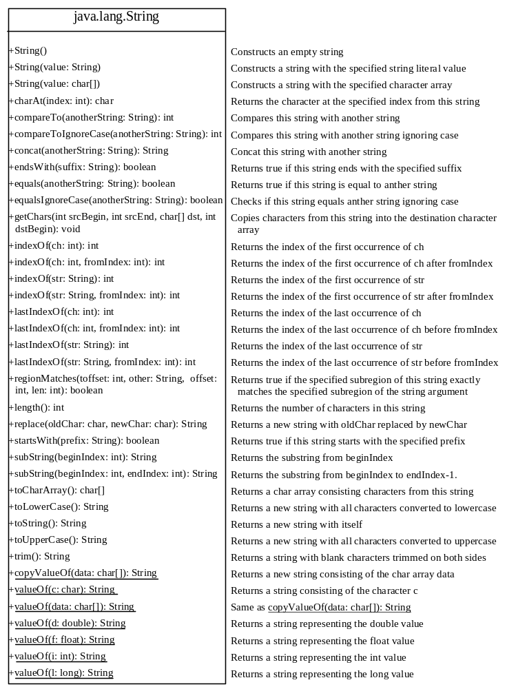

Slide 3
Constructing Strings
String newString = new String(stringLiteral);
String message = new String("Welcome to Java");
Since strings are used frequently, Java provides a shorthand initializer for creating a string:
String message = "Welcome to Java";

Slide 4
Strings Are Immutable
A String object is immutable; its contents cannot be changed. Does the following code change the contents of the string?
String s = "Java";
s = "HTML";

Slide 5

Trace Code
animation
String s = "Java";
s = "HTML";

Slide 6
Trace Code
animation
String s = "Java";
s = "HTML";

Slide 7
Interned Strings
Since strings are immutable and are frequently used, to improve efficiency and save memory, the JVM uses a unique instance for string literals with the same character sequence. Such an instance is called interned. You can also use a String object’s intern method to return an interned string. For example, the following statements:

Slide 8
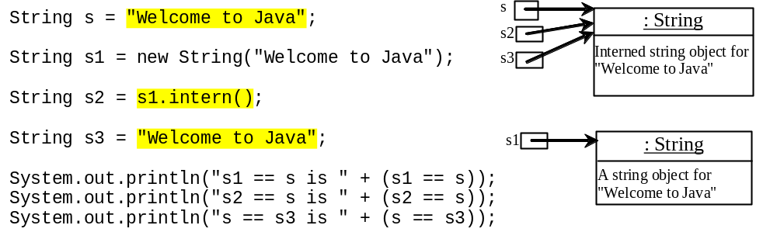
Examples
display
s1 == s is false
s2 == s is true
s == s3 is true
A new object is created if you use the new operator.
If you use the string initializer, no new object is created if the interned object is already created.

Slide 9
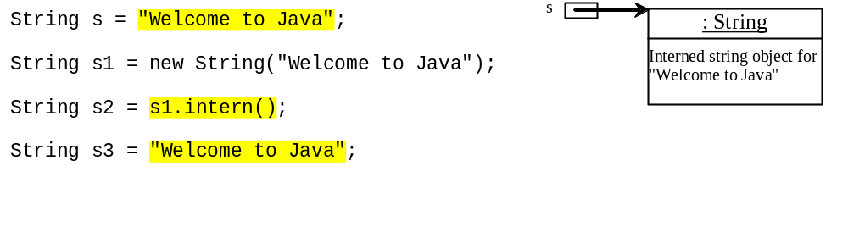
Trace Code
animation

Slide 10
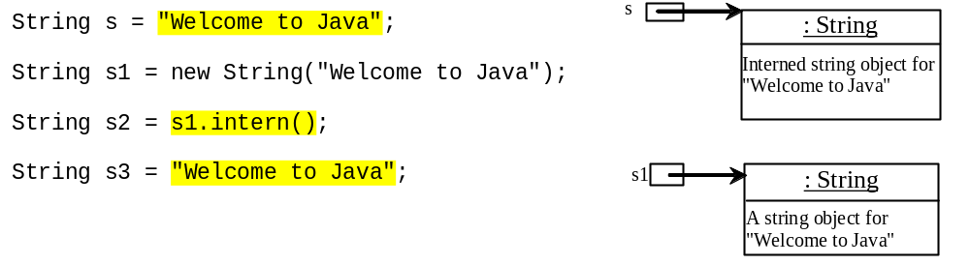
Trace Code

Slide 11
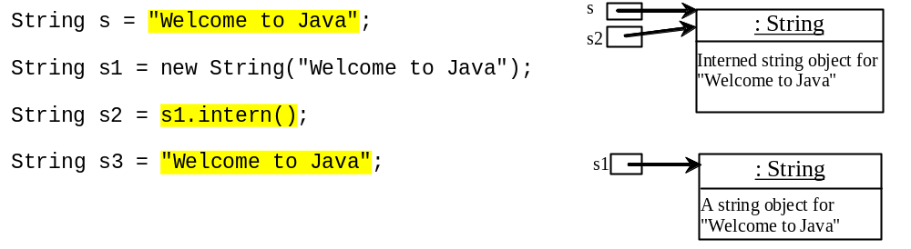
Trace Code

Slide 12
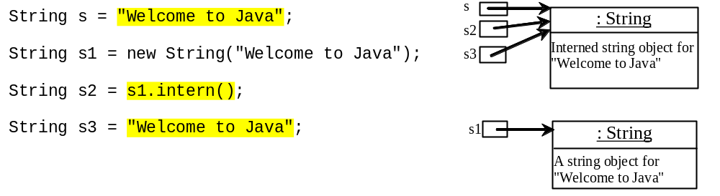
Trace Code

Slide 13
Finding String Length
Finding string length using the length() method:
message = "Welcome";
message.length() (returns 7)

Slide 14
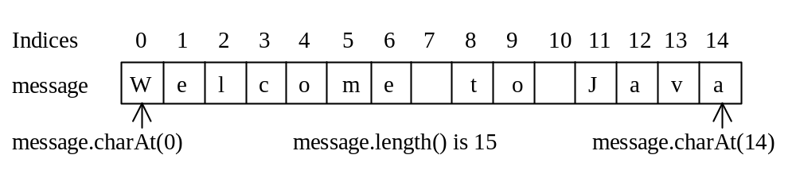
Retrieving Individual Characters in a String
Do not use message[0]
Use message.charAt(index)
Index starts from 0

Slide 15
String Concatenation
String s3 = s1.concat(s2);
String s3 = s1 + s2;
s1 + s2 + s3 + s4 + s5 same as
(((s1.concat(s2)).concat(s3)).concat(s4)).concat(s5);

Slide 16
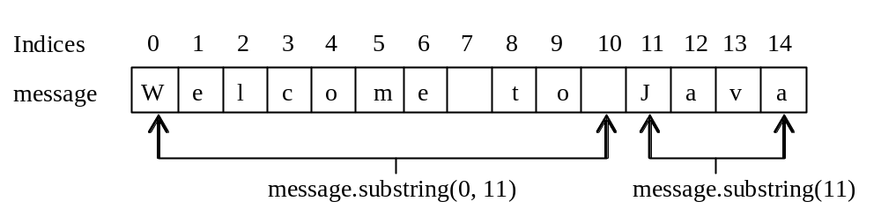
Extracting Substrings
You can extract a single character from a string using the charAt method. You can also extract a substring from a string using the substring method in the String class.
String s1 = "Welcome to Java";
String s2 = s1.substring(0, 11) + "HTML";

Slide 17
String Comparisons
equals
String s1 = new String("Welcome“);
String s2 = "welcome";
if (s1.equals(s2)){
// s1 and s2 have the same contents
}
if (s1 == s2) {
// s1 and s2 have the same reference
}

Slide 18
String Comparisons, cont.
compareTo(Object object)
String s1 = new String("Welcome“);
String s2 = "welcome";
if (s1.compareTo(s2) > 0) {
// s1 is greater than s2
}
else if (s1.compareTo(s2) == 0) {
// s1 and s2 have the same contents
}
else
// s1 is less than s2

Slide 19
String Conversions
The contents of a string cannot be changed once the string is created. But you can convert a string to a new string using the following methods:
toLowerCase
toUpperCase
trim
replace(oldChar, newChar)

Slide 20
Finding a Character or a Substring in a String
"Welcome to Java".indexOf('W') returns 0.
"Welcome to Java".indexOf('x') returns -1.
"Welcome to Java".indexOf('o', 5) returns 9.
"Welcome to Java".indexOf("come") returns 3.
"Welcome to Java".indexOf("Java", 5) returns 11.
"Welcome to Java".indexOf("java", 5) returns -1.
"Welcome to Java".lastIndexOf('a') returns 14.

Slide 21
Convert Character and Numbers to Strings
The String class provides several static valueOf methods for converting a character, an array of characters, and numeric values to strings. These methods have the same name valueOf with different argument types char, char[], double, long, int, and float. For example, to convert a double value to a string, use String.valueOf(5.44). The return value is string consists of characters ‘5’, ‘.’, ‘4’, and ‘4’.

Slide 22
Examples
Character charObject = new Character('b');
charObject.compareTo(new Character('a')) returns 1
charObject.compareTo(new Character('b')) returns 0
charObject.compareTo(new Character('c')) returns -1
charObject.compareTo(new Character('d') returns –2
charObject.equals(new Character('b')) returns true
charObject.equals(new Character('d')) returns false

Slide 23
StringBuilder and StringBuffer
The StringBuilder/StringBuffer class is an alternative to the String class. In general, a StringBuilder/StringBuffer can be used wherever a string is used. StringBuilder/StringBuffer is more flexible than String. You can add, insert, or append new contents into a string buffer, whereas the value of a String object is fixed once the string is created.

Slide 24
StringBuilder vs. StringBuffer
The StringBuilder class, introduced in JDK 1.5, is similar to StringBuffer except that the update methods in StringBuffer are synchronized. Use StringBuffer if it may be accessed by multiple tasks concurrently. Using StringBuilder is more efficient if it is accessed by a single task. The constructors and methods in StringBuffer and StringBuilder are almost the same.

Slide 25
The StringBuffer Class
The StringBuffer class is an alternative to the String class. In general, a string buffer can be used wherever a string is used.
StringBuffer is more flexible than String. You can add, insert, or append new contents
into a string buffer. However, the value of
a String object is fixed once the string is created.

Slide 26
StringBuffer Constructors
public StringBuffer()
No characters, initial capacity 16 characters.
public StringBuffer(int length)
No characters, initial capacity specified by the length argument.
public StringBuffer(String str)
Represents the same sequence of characters
as the string argument. Initial capacity 16
plus the length of the string argument.

Slide 27
Appending New Contents into a String Buffer
StringBuffer strBuf = new StringBuffer();
strBuf.append("Welcome");
strBuf.append(' ');
strBuf.append("to");
strBuf.append(' ');
strBuf.append("Java");

Slide 28
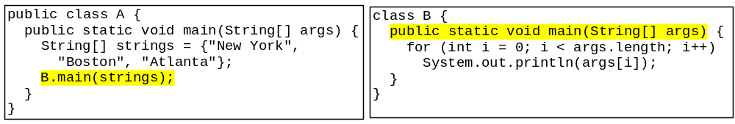
Main Method Is Just a Regular Method
You can call a regular method by passing actual parameters. Can you pass arguments to main? Of course, yes. For example, the main method in class B is invoked by a method in A, as shown below:

Slide 29
Pedagogical(শিক্ষনবিজ্ঞানসংক্রান্ত) NOTE
The previous edition of this book introduced the StringTokenizer class for extracting tokens from a string. Using regular expressions is more powerful and flexible than StringTokenizer for splitting strings. Therefore, StringTokenizer is obsolete.

Slide 30
Regular Expressions
Optional
A regular expression (abbreviated regex) is a string that describes a pattern for matching a set of strings.
Regular expression is a powerful tool for string manipulations. You can use regular expressions for matching, replacing, and splitting strings.

Slide 31
Matching Strings
Optional
"Java".matches("Java");
"Java".equals("Java");
"Java is fun".matches("Java.*")
"Java is cool".matches("Java.*")
"Java is powerful".matches("Java.*")

Slide 32
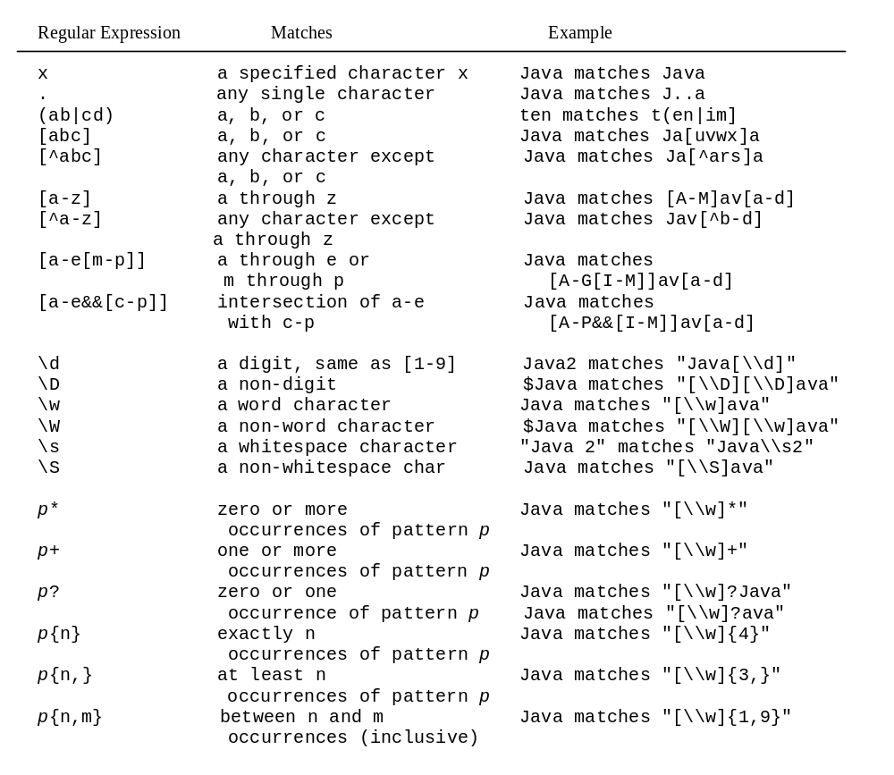
Regular Expression Syntax
Optional

Slide 33
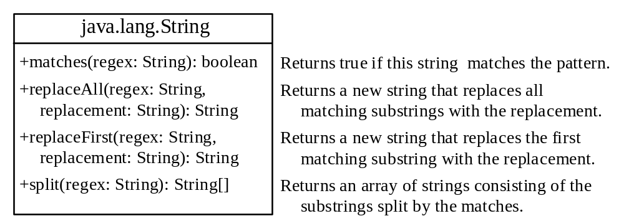
Replacing and Splitting Strings
Optional

Slide 34
Examples
String s = "Java Java Java".replace("a", "k") ;
String s = "Java Java Java".replaceAll("v\\w", "wi") ;
String s = "Java Java Java".replaceFirst("v\\w", "wi") ;
String[] s = "Java1HTML2Perl".split("\\d");

Slide 35
The File Class
The File class is intended to provide an abstraction that deals with most of the machine-dependent complexities of files and path names in a machine-independent fashion.
The filename is a string. The File class is a wrapper class for the file name and its directory path.

Slide 36
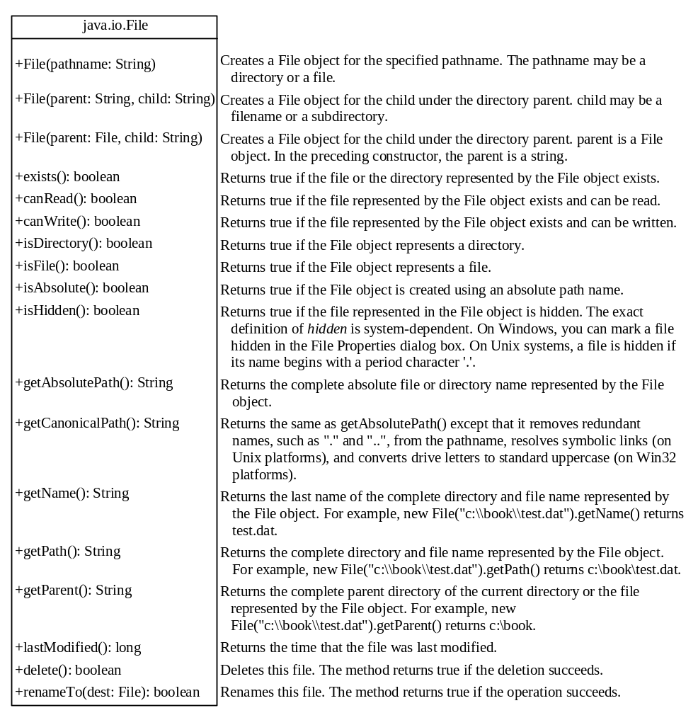
Obtaining file properties and manipulating file

Slide 37
Text I/O
A File object encapsulates the properties of a file or a path, but does not contain the methods for reading/writing data from/to a file. In order to perform I/O, you need to create objects using appropriate Java I/O classes. The objects contain the methods for reading/writing data from/to a file.
This section introduces how to read/write strings and numeric values from/to a text file using the Scanner and PrintWriter classes.

Slide 38

Writing Data Using PrintWriter
WriteData
Run

Slide 39
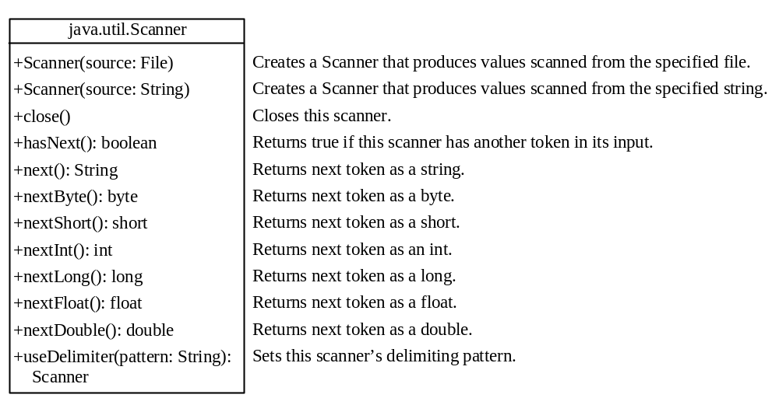
Reading Data Using Scanner
ReadData
Run

Slide 40
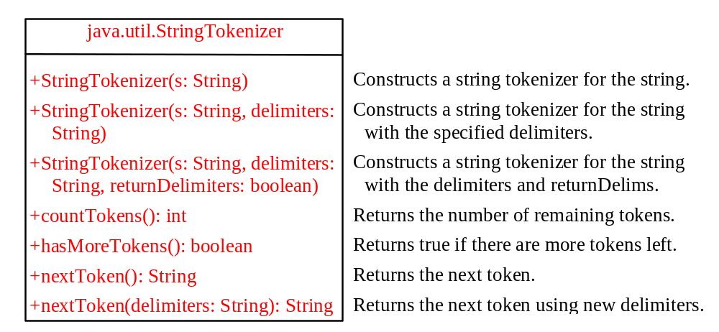
The StringTokenizer Class

Slide 41
Examples 1
  String s = "Java is cool.";
  StringTokenizer tokenizer = new StringTokenizer(s);
  System.out.println("The total number of tokens is " +
  tokenizer.countTokens());
  while (tokenizer.hasMoreTokens())
  System.out.println(tokenizer.nextToken());
The code displays
    The total number of tokens is 3
    Java
    is
    cool.

Slide 42
Examples 2
  String s = "Java is cool.";
  StringTokenizer tokenizer = new StringTokenizer(s, "ac");
  System.out.println("The total number of tokens is " +
  tokenizer.countTokens());
  while (tokenizer.hasMoreTokens())
  System.out.println(tokenizer.nextToken());
The code displays
    The total number of tokens is 4
    J
    v
    is
    ool.

Slide 43
Examples 3
  String s = "Java is cool.";
  StringTokenizer tokenizer = new StringTokenizer(s, "ac", ture);
  System.out.println("The total number of tokens is " +
  tokenizer.countTokens());
  while (tokenizer.hasMoreTokens())
  System.out.println(tokenizer.nextToken());
The code displays
    The total number of tokens is 7
    J
    a
    v
    a
    is
    c
    ool.

Slide 44
No no-arg Constructor in StringTokenizer
The StringTokenizer class does not have a no-arg constructor. Normally it is a good programming practice to provide a no-arg constructor for each class.
On rare occasions, however, a no-arg constructor does not make sense. StringTokenizer is such an example. A StringTokenizer object must be created for a string, which should be passed as an argument from a constructor.

Slide 45
The Scanner Class
JDK 1.5
Feature
The delimiters are single characters in StringTokenizer. You can use the new JDK 1.5 java.util.Scanner class to specify a word as a delimiter.
String s = "Welcome to Java! Java is fun! Java is cool!";
Scanner scanner = new Scanner(s);
scanner.useDelimiter("Java");
while (scanner.hasNext())
System.out.println(scanner.next());
Creates an instance of Scanner for the string.
Sets “Java” as a delimiter.
hasNext() returns true if there are still more tokens left.
The next() method returns a token as a string.
Welcome to
!
is fun!
is cool!
Output

Slide 46
Scanning Primitive Type Values
JDK 1.5
Feature
If a token is a primitive data type value, you can use the methods nextByte(), nextShort(), nextInt(), nextLong(), nextFloat(), nextDouble(), or nextBoolean() to obtain it. For example, the following code adds all numbers in the string. Note that the delimiter is space by default.
String s = "1 2 3 4";
Scanner scanner = new Scanner(s);
int sum = 0;
while (scanner.hasNext())
sum += scanner.nextInt();
System.out.println("Sum is " + sum);

Slide 47
Console Input Using Scanner
JDK 1.5
Feature
Another important application of the Scanner class is to read input from the console. For example, the following code reads an int value from the keyboard:
System.out.print("Please enter an int value: ");
Scanner scanner = new Scanner(System.in);
int i = scanner.nextInt();
NOTE: StringTokenizer can specify several single characters as delimiters. Scanner can use a single character or a word as the delimiter. So, if you need to scan a string with multiple single characters as delimiters, use StringTokenizer. If you need to use a word as the delimiter, use Scanner.

